Slide 2

WHEN DID YOU LAST WATCH T.V?

Slide 3

We don’t watch T.V
anymore

Slide 4

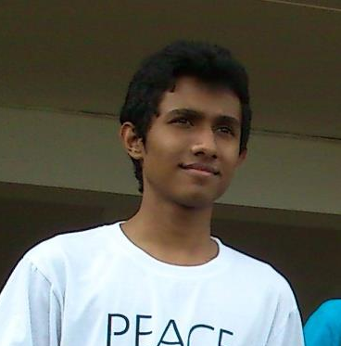



Saarah
Muthaliff
Field of study:
International Business Management
(Intern Customer Development USL)
Last Watched T.V
2 years ago
Netflix
Haritha Jayasinghe
Field of study:
Computer Science and Engineering
(3rd Year Undergraduate)
Last Watched T.V
2 weeks ago
Medium
Yashoda Gamage
Field of study:
Transport and Logistics Management
(Management Trainee USL)
Last Watched T.V
Last week
Insta Stories
Pulasthi Ekanayake
Field of study:
Biomedical Engineering
(3rd Year Undergraduate)
Last Watched T.V
1 year ago
Flipboard
Shilpa Gunawardena
Field of study:
Business Systems Engineering
(Intern Data Analytics MAS)
Last Watched T.V
3 months ago
LinkedIn

Slide 5
Why?
We don't have the time.
TV shows are too long
PeoTV allows us to skip commercials
Netflix / Online Streaming doesn't have commercials
TV's are not portable
YouTube provides short entertainment
We can be a part of the story on YouTube

Slide 6




85%
78%
74%
20%

Slide 7
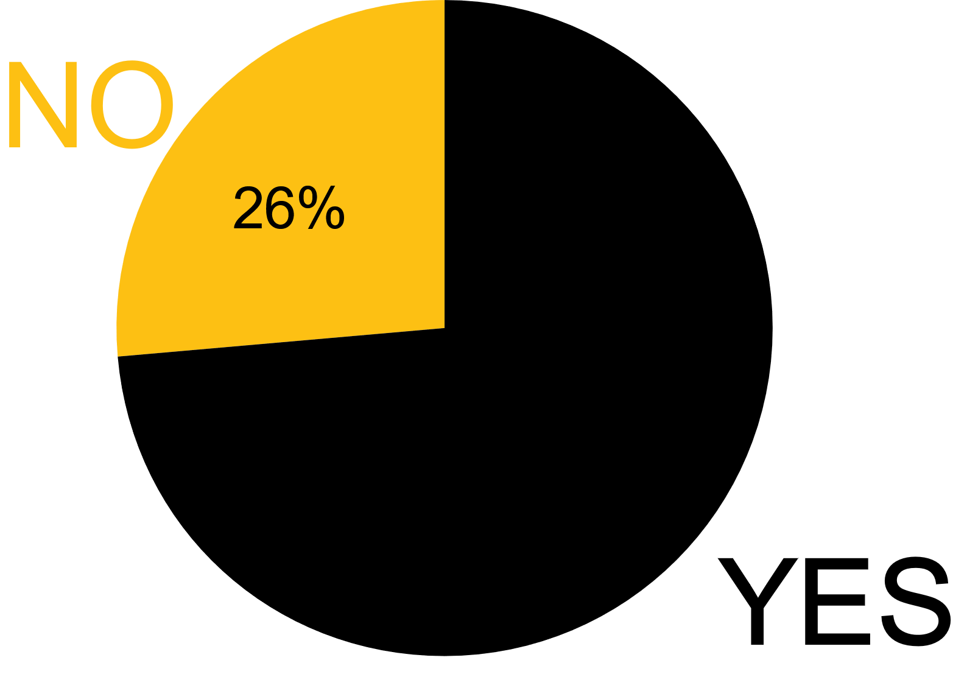
Do you watch
T.V

Slide 8
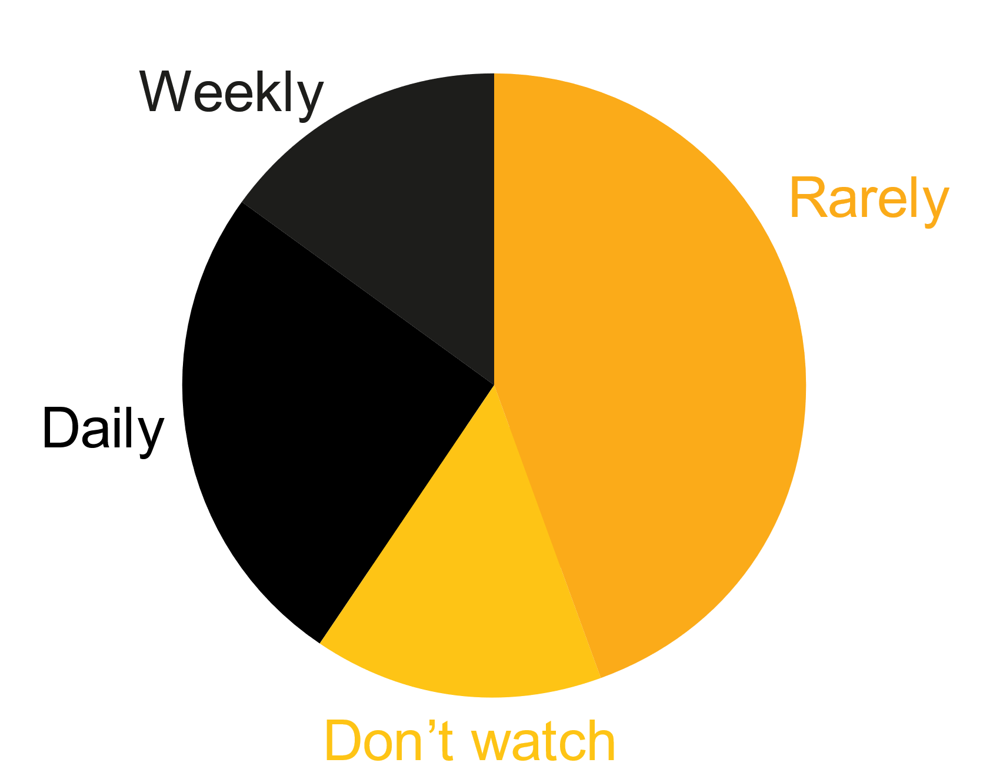
How often do you watch T.V
Do you watch T.V

Slide 9

Suggestions
Experiment
More emphasis on the Unilever brand
Move beyond advertisements

Slide 10

Suggestions
Connect with us on the mediums we use
The rule of 7 may not apply anymore
Focus more on the content

Slide 11
Thank You

Slide 12
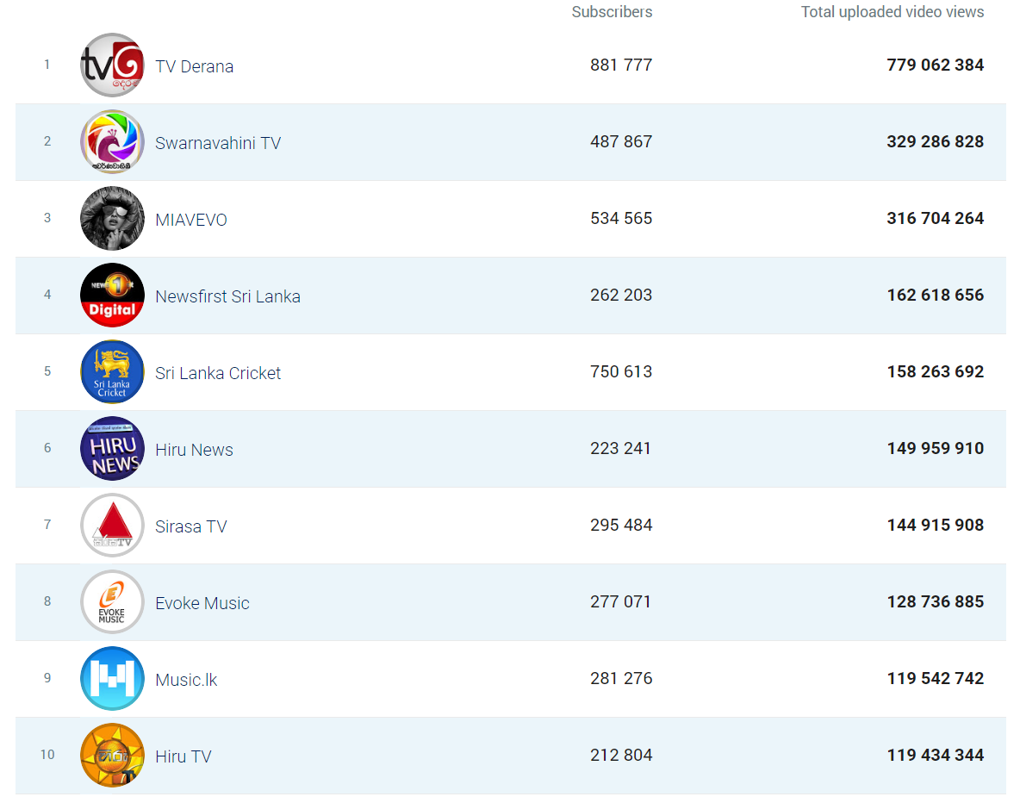

Slide 13
